Slide 1

Material and
Cross-section properties
BOA001
Ing. Martin Vild, Ph.D.
9/2024

Slide 2



Presenting
Ing. Martin Vild, Ph.D.
IDEA StatiCa – Product Owner
FCE BUT – Assistant professor
Research:
Steel connections
Finite element analysis
Scopus Author ID: 56188615700
Committee member:
CEN/TC 250/SC 3/WG 8 "Evolution of EN 1993-1-8 - Joints and connections“
ECCS TC10 “Structural Connections”
Website:
https://www.fce.vutbr.cz/KDK/vild.m/
email: martin.vild@vutbr.cz
Office: C203
Consultations:
Thursday 10–11

Slide 3
Content
Concrete vs Steel, which material to use?
Repetition makes masters
  Snow load “+” Wind load “+” Dead load
Material
  Steel
  Timber
Connections
  Bolts
  Welds
Member design
  Tension/Compression
  Bending
  Shear
  Torsion

Slide 4
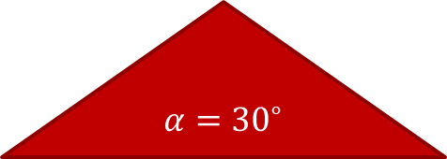

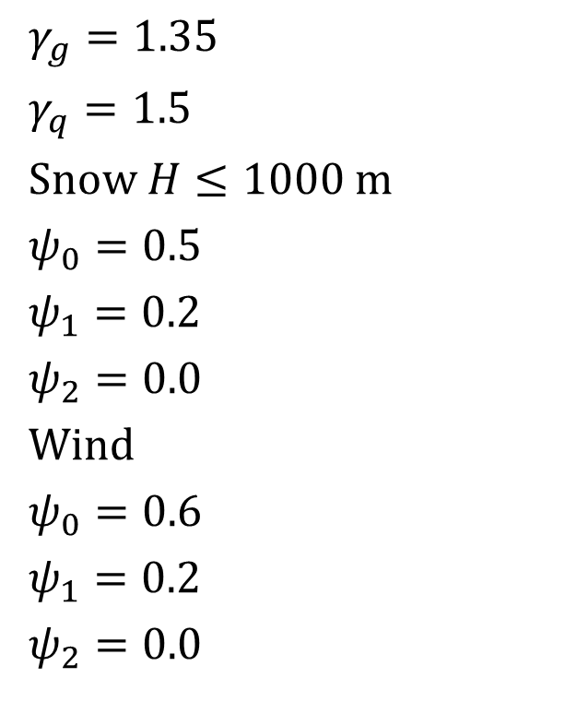
Load combination
$s_{k}=1.2$ kN/m²
$w_{k,suction}=−2.0$ kN/m²
$w_{k,pressure}=1.0$ kN/m²
$g_{k}=0.5$ kN/m²
$γ_{g}=1.35$
$γ_{q}=1.5$
Snow $H≤1000 m$
$ψ_{0}=0.5$
$ψ_{1}=0.2$
$ψ_{2}=0.0$
Wind
$ψ_{0}=0.6$
$ψ_{1}=0.2$
$ψ_{2}=0.0$
$α={30}^{∘}$

Slide 5
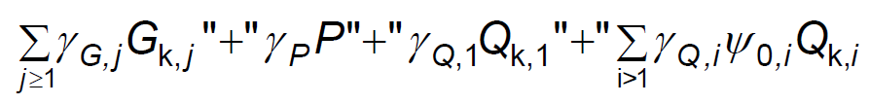
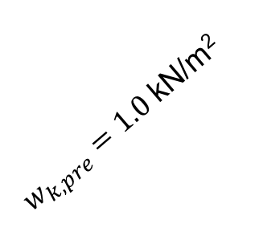


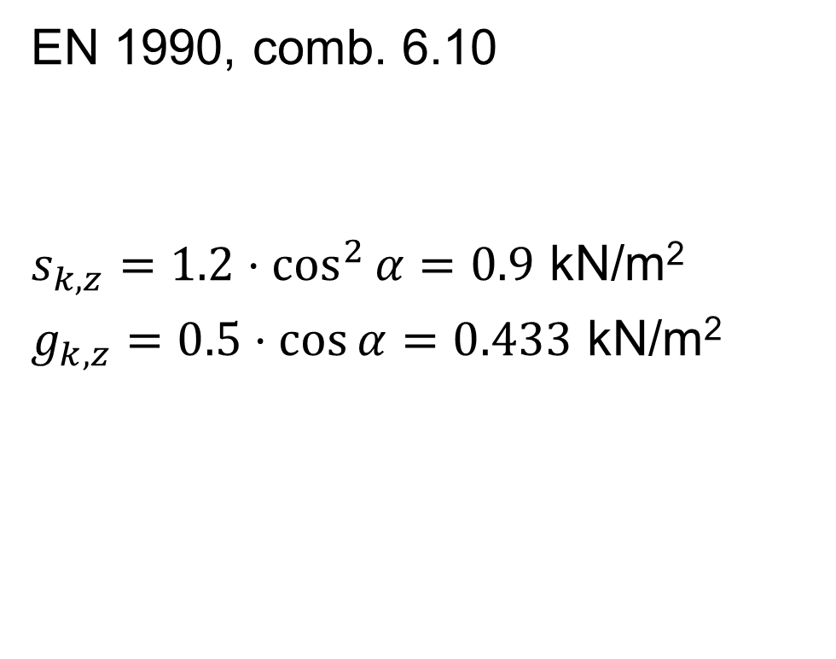
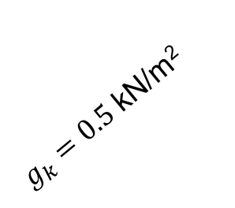

Load combination
$s_{k}=1.2$kN/m²
EN 1990, comb. 6.10
$s_{k,z}=1.2⋅\cos^{2}{α}=0.9$ kN/m²
$g_{k,z}=0.5⋅\cos{α}=0.433$ kN/m²
$g_{k}=0.5$ kN/m²
$α={30}^{∘}$
$w_{k,pre}=1.0$ kN/m²
$$z$$

Slide 6
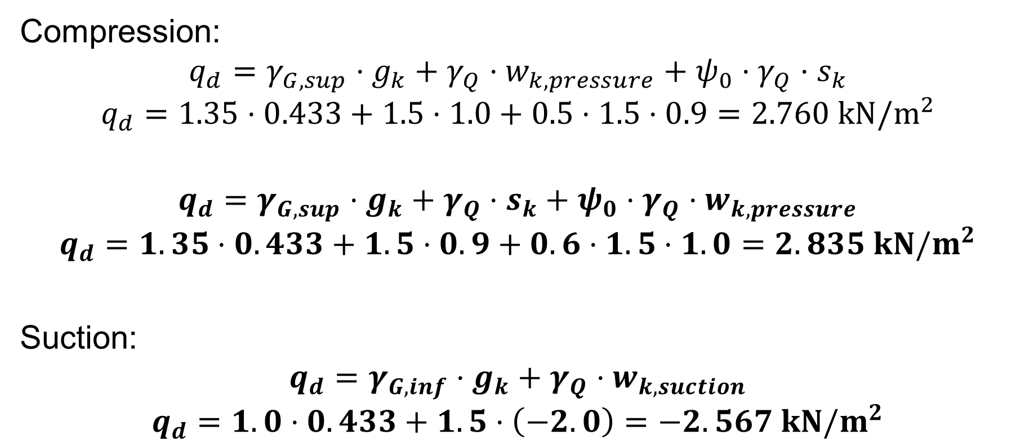
Load combination
Compression:
$$q_{d}=γ_{G,sup}⋅g_{k}+γ_{Q}⋅w_{k,pressure}+ψ_{0}⋅γ_{Q}⋅s_{k}$$
$$q_{d}=1.35⋅0.433+1.5⋅1.0+0.5⋅1.5⋅0.9=2.760 kN/m^{2}$$
$$q_{d}=γ_{G,sup}⋅g_{k}+γ_{Q}⋅s_{k}+ψ_{0}⋅γ_{Q}⋅w_{k,pressure}$$
$$q_{d}=1.35⋅0.433+1.5⋅0.9+0.6⋅1.5⋅1.0=2.835 kN/m^{2}$$
Suction:
$$q_{d}=γ_{G,inf}⋅g_{k}+γ_{Q}⋅w_{k,suction}$$
$$q_{d}=1.0⋅0.433+1.5⋅\left(−2.0\right)=−2.567 kN/m^{2}$$

Slide 7
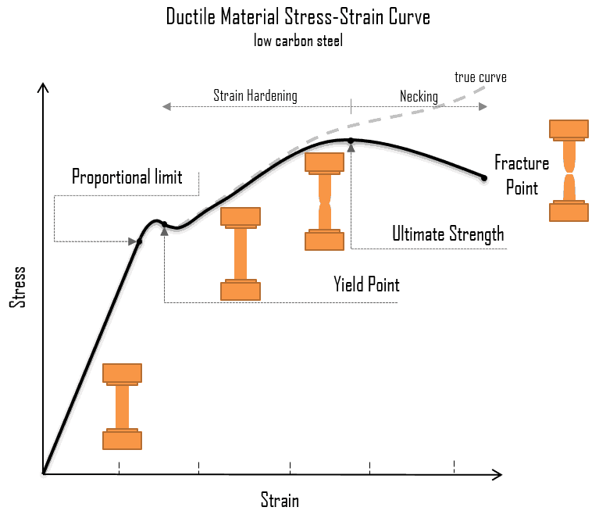
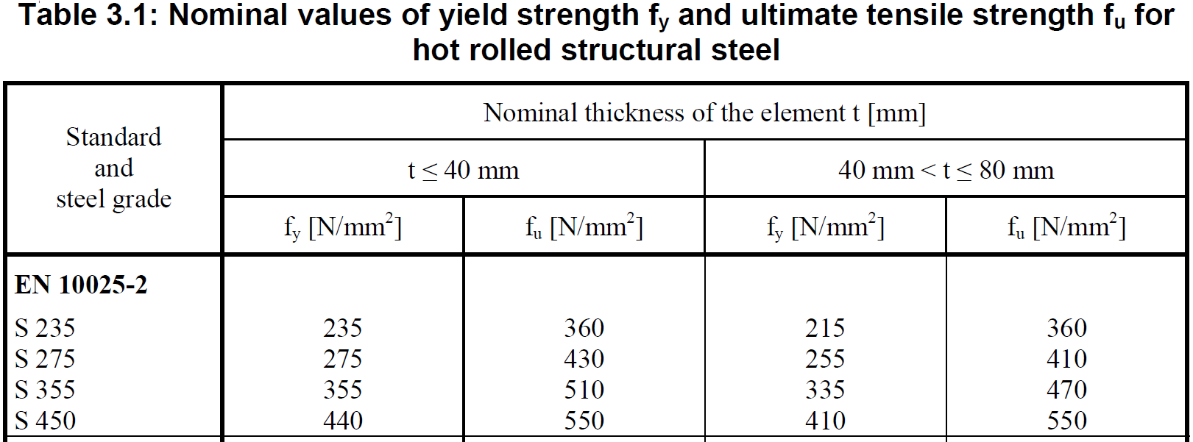
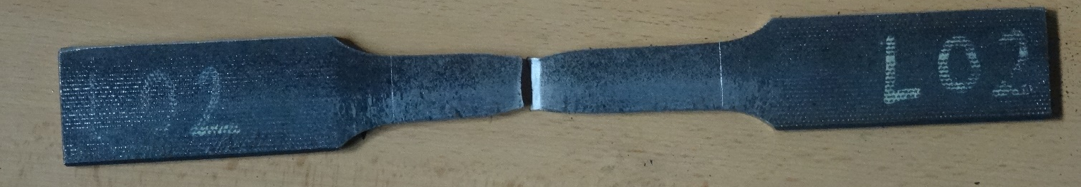
Material – Steel
EN 1993
https://material-properties.org/what-is-ultimate-tensile-strength-uts-definition/

Slide 8
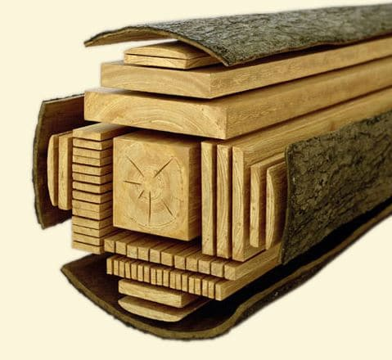
Material – Timber
EN 1995
Orthotropic
Many types:
  Solid timber
  Glued lamilated timber
  LVL, plywood, OSB
  Particleboard, Fibreboard

Slide 9
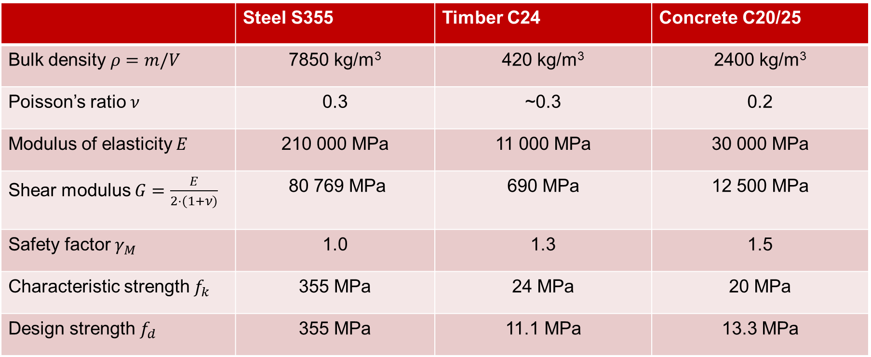
Material properties
 | Steel S355 | Timber C24 | Concrete C20/25
Bulk density $ρ=m/V$ | 7850 kg/m³ | 420 kg/m³ | 2400 kg/m³
Poisson’s ratio $ν$ | 0.3 | ~0.3 | 0.2
Modulus of elasticity $E$ | 210 000 MPa | 11 000 MPa | 30 000 MPa
Shear modulus $G=\frac{E}{2⋅(1+ν)}$ | 80 769 MPa | 690 MPa | 12 500 MPa
Safety factor $γ_{M}$ | 1.0 | 1.3 | 1.5
Characteristic strength $f_{k}$ | 355 MPa | 24 MPa | 20 MPa
Design strength $f_{d}$ | 355 MPa | 11.1 MPa | 13.3 MPa

Slide 10
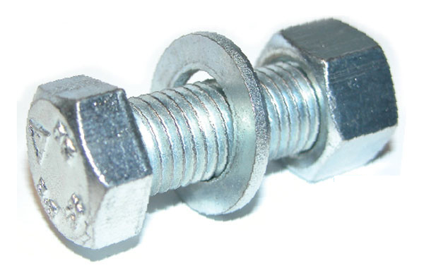
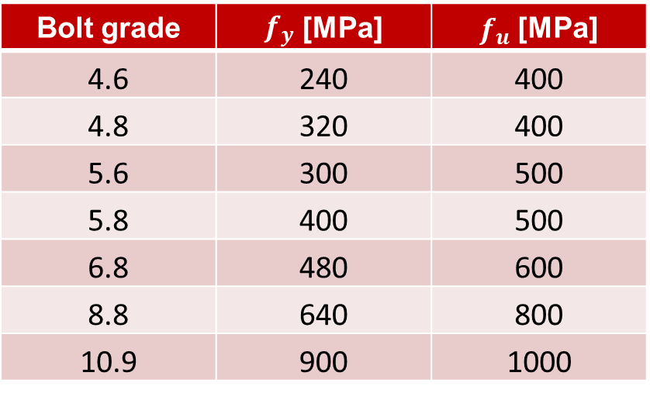
Connections – Bolts
Material: ISO 898-1
Sizes: ISO 4014
Bolt grade | $f_{y}$ [MPa] | $f_{u}$[MPa]
4.6 | 240 | 400
4.8 | 320 | 400
5.6 | 300 | 500
5.8 | 400 | 500
6.8 | 480 | 600
8.8 | 640 | 800
10.9 | 900 | 1000
https://www.orbitalfasteners.co.uk/

Slide 11
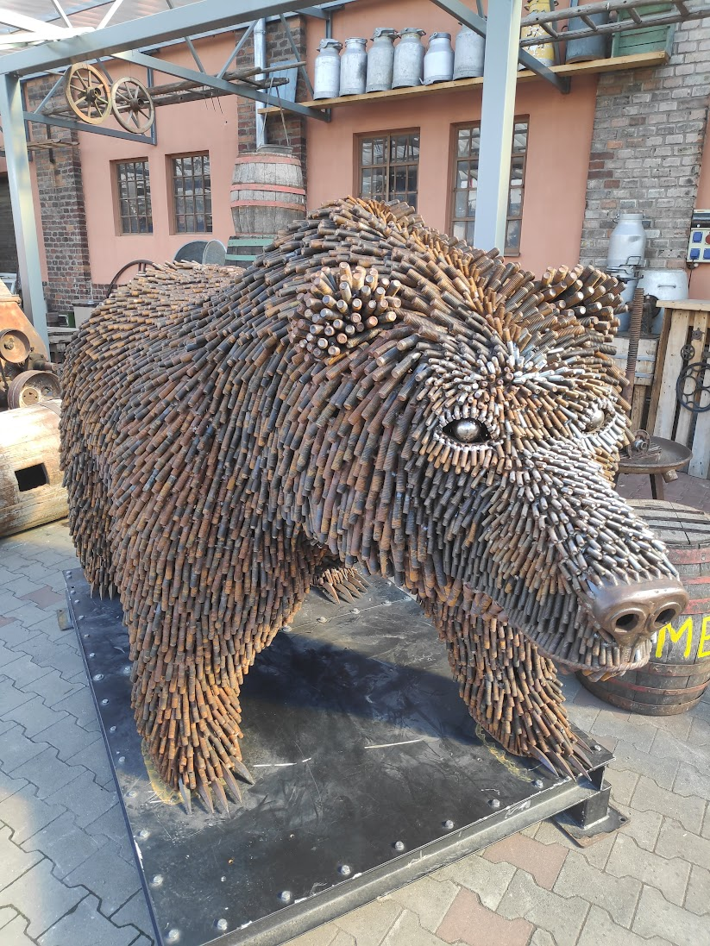
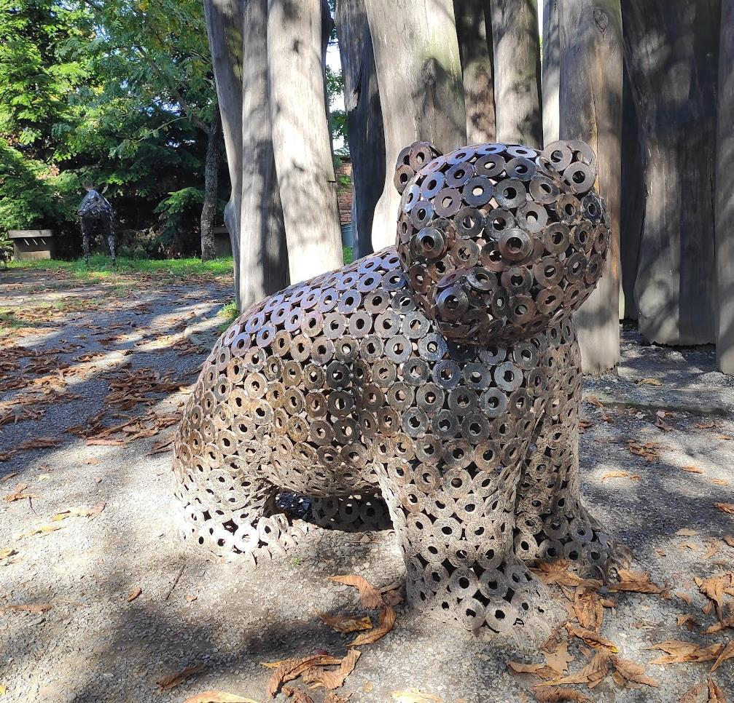
Kovozoo, Staré Město

Slide 12
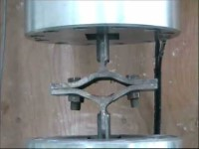

Slide 13
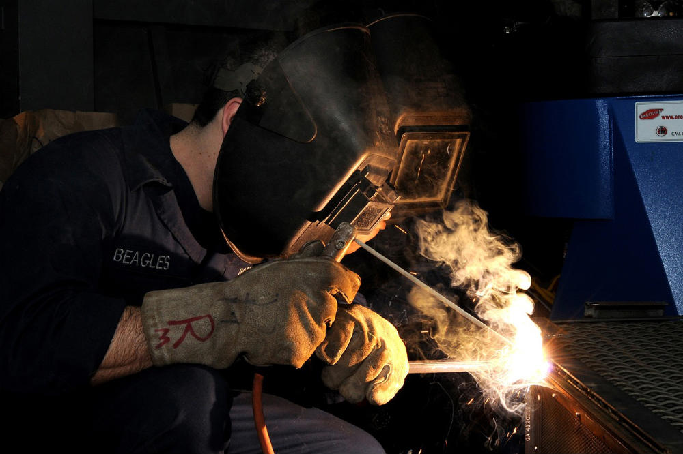
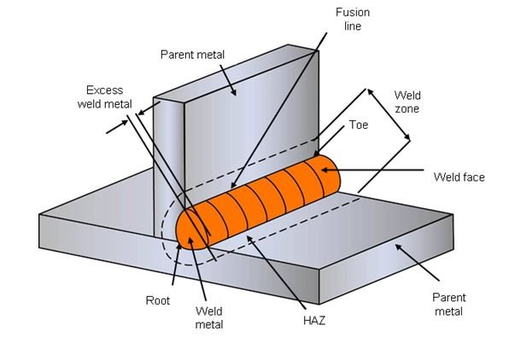
Connections – Welds
https://northern-weldarc.com/types-welding-processes/
https://www.twi-global.com/technical-knowledge/faqs/what-is-welding

Slide 14
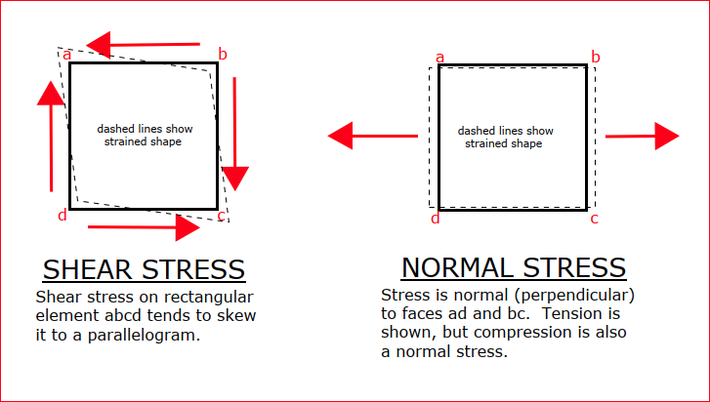
Stresses

Slide 15
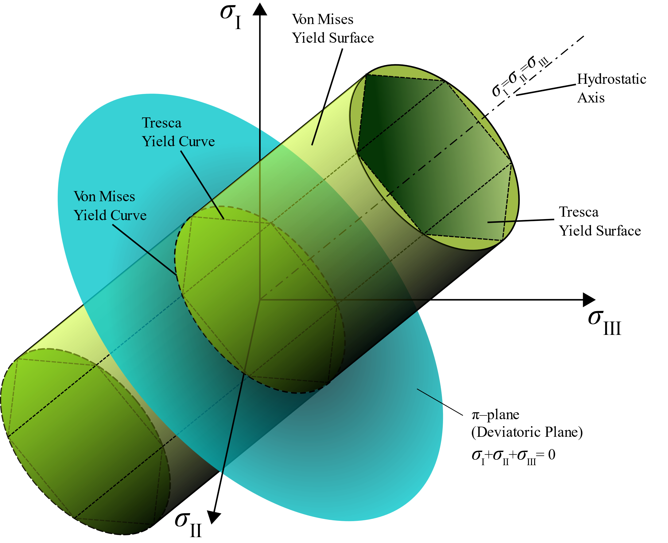
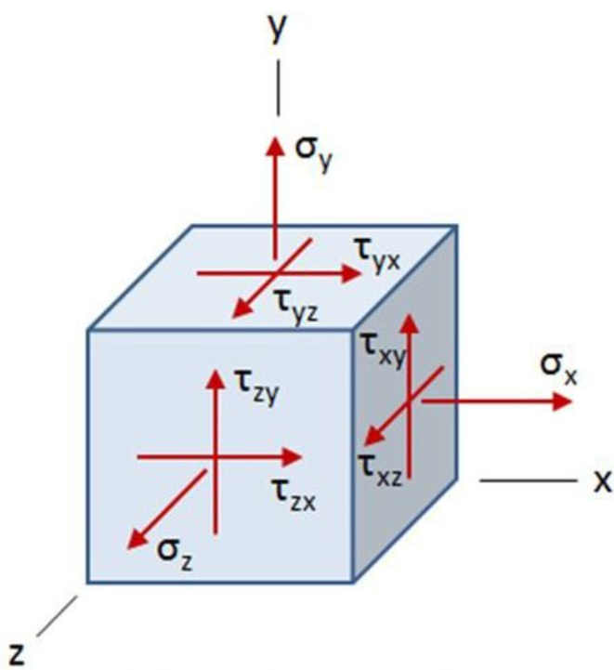
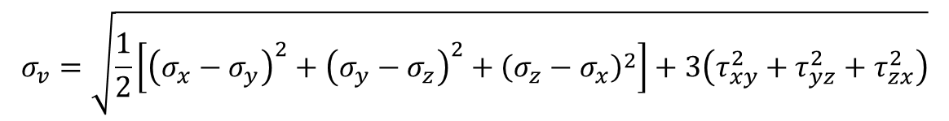
von Mises stress
$$σ_{v}=\sqrt{\frac{1}{2}\left[{\left(σ_{x}−σ_{y}\right)}^{2}+{\left(σ_{y}−σ_{z}\right)}^{2}+{\left(σ_{z}−σ_{x}\right)}^{2}\right]+3\left(τ_{xy}^{2}+τ_{yz}^{2}+τ_{zx}^{2}\right)}$$
https://en.wikipedia.org/wiki/Von_Mises_yield_criterion

Slide 16


von Mises stress
Impact on member design:
Normal stress
  Tension & compression: $N_{Rd}=A⋅f_{y}$
  Bending: $M_{y,el,Rd}=W_{y,el}⋅f_{y}$
Shear
  $V_{z,Rd}=A_{V}⋅f_{y}/\sqrt{3}$
Combination:
for $V_{Ed}≥0.5V_{pl,Rd}:$
$f_{y,reduced}=\left(1−ρ\right)f_{y}$
$ρ={\left(\frac{2V_{Ed}}{V_{pl,Rd}}−1\right)}^{2}$

Slide 17
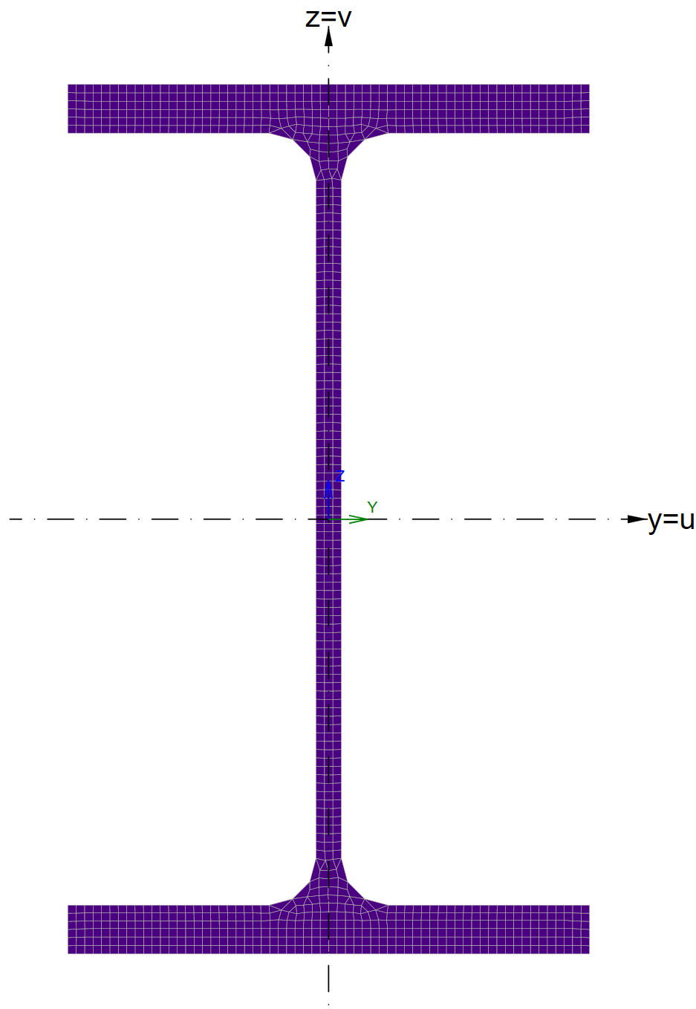

Tension & Compression
Integral $A=\int_{A}{dA}$
Discrete $A=\sum_{i=1}^{n}{b_{i}⋅t_{i}}$

Slide 18
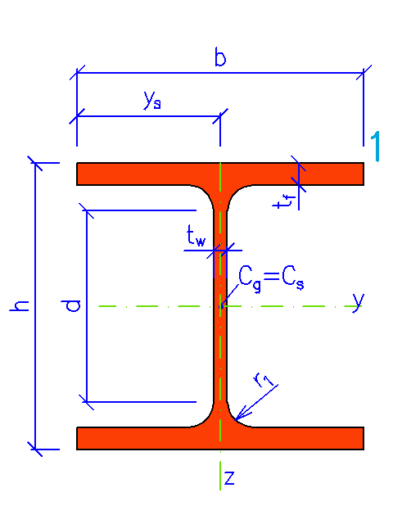

Example
Calculate area of cross-section HEB 500
Calculate tensile resistance of HEB 500
h = 500 mm
b = 300 mm
t_{f} = 28 mm
t_{w} = 14.5 mm
r₁ = 27 mm
d = 390 mm
Roughly (5 minutes)
Exactly (who has time)
$$F_{Rd}=A⋅\frac{f_{yk}}{γ_{M0}}$$
$$f_{yk}=355 MPa$$
$$γ_{M0}=1.0$$
http://www.staticstools.eu/cs/profile-heb/HE500B/mm/show

Slide 19
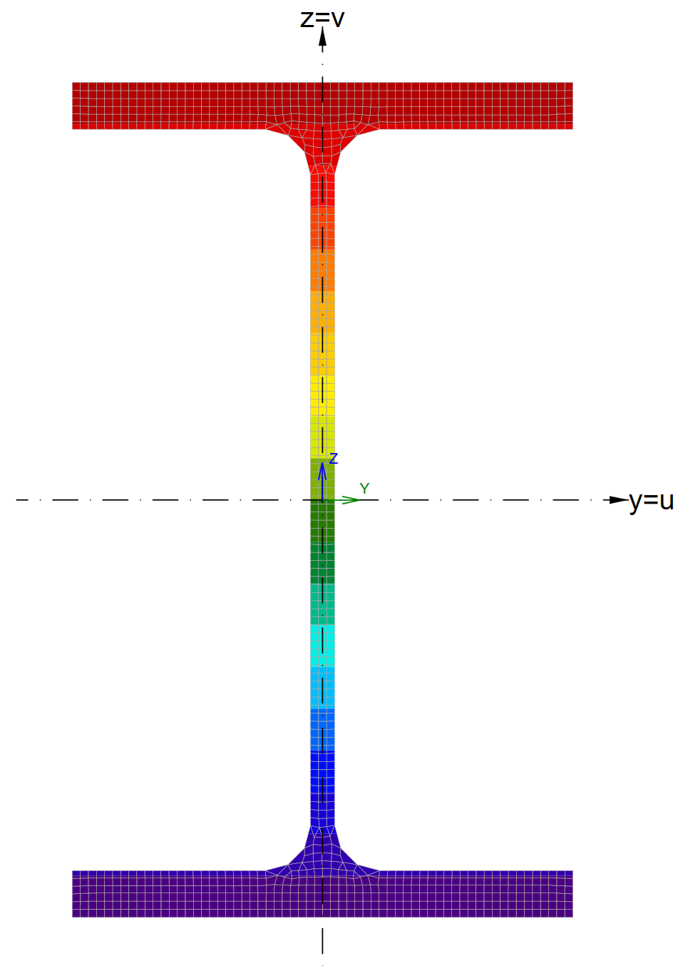
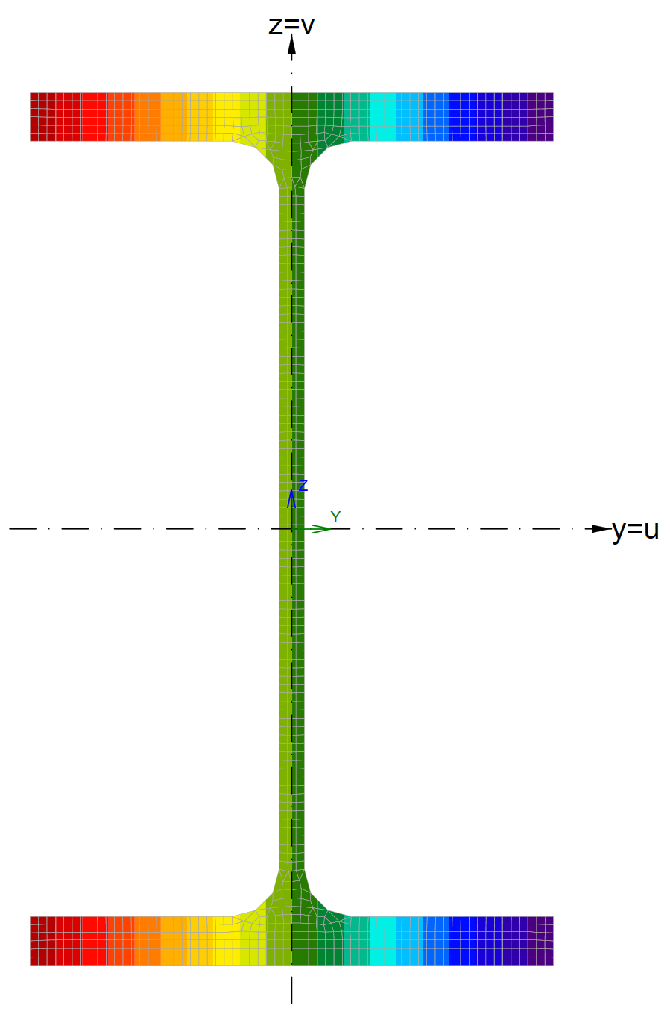






Bending – stiffness
$$M_{y,Ed}$$
$$M_{z,Ed}$$
$I_{y}=\int_{A}{z^{2}dA}$
$I_{y}=\sum_{i=1}^{n}{\frac{1}{12}b_{i}⋅h_{i}^{3}+b_{i}⋅h_{i}⋅z_{i}^{2}}$
$I_{z}=\int_{A}{y^{2}dA}$
$I_{z}=\sum_{i=1}^{n}{\frac{1}{12}h_{i}⋅b_{i}^{3}+b_{i}⋅h_{i}⋅y_{i}^{2}}$
$$z_{3}$$
$$h_{3}$$
$$b_{3}$$

Slide 20



Bending – resistance
$$M_{y,Ed}$$
$$M_{z,Ed}$$
$W_{el,y}=I_{y}/z_{c}$
$W_{el,z}=I_{z}/y_{c}$
$$z_{c}$$
$$y_{c}$$

Slide 21
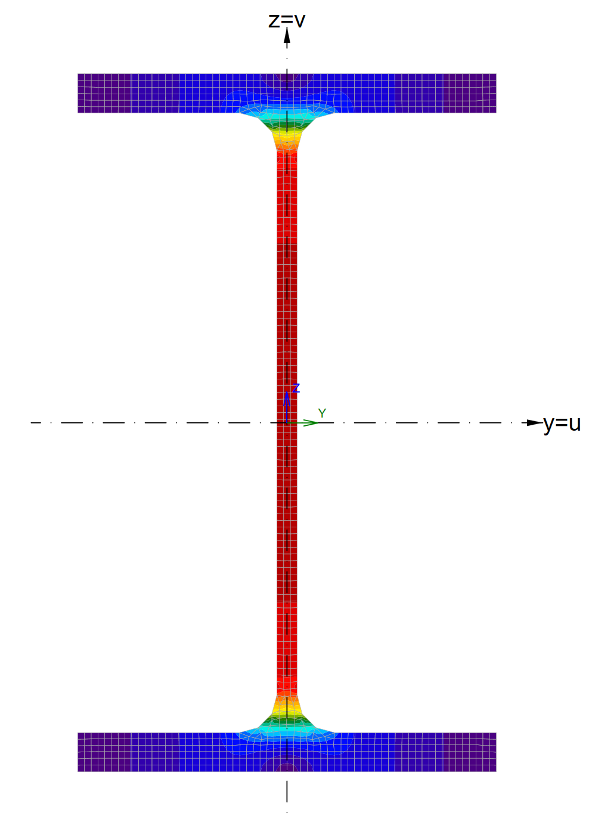
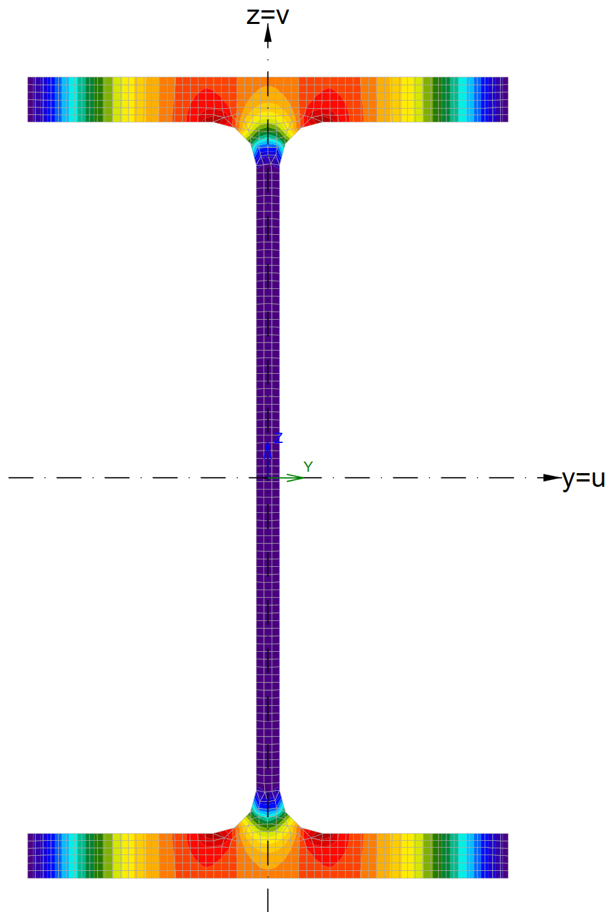







Shear
$$V_{z,Ed}$$
$$V_{y,Ed}$$
Simplified:
$A_{Vz}=t_{w}⋅h$
$A_{Vy}=t_{f}⋅b$
$$t_{w}$$
$$h$$
$$t_{f}$$
$$b$$

Slide 22
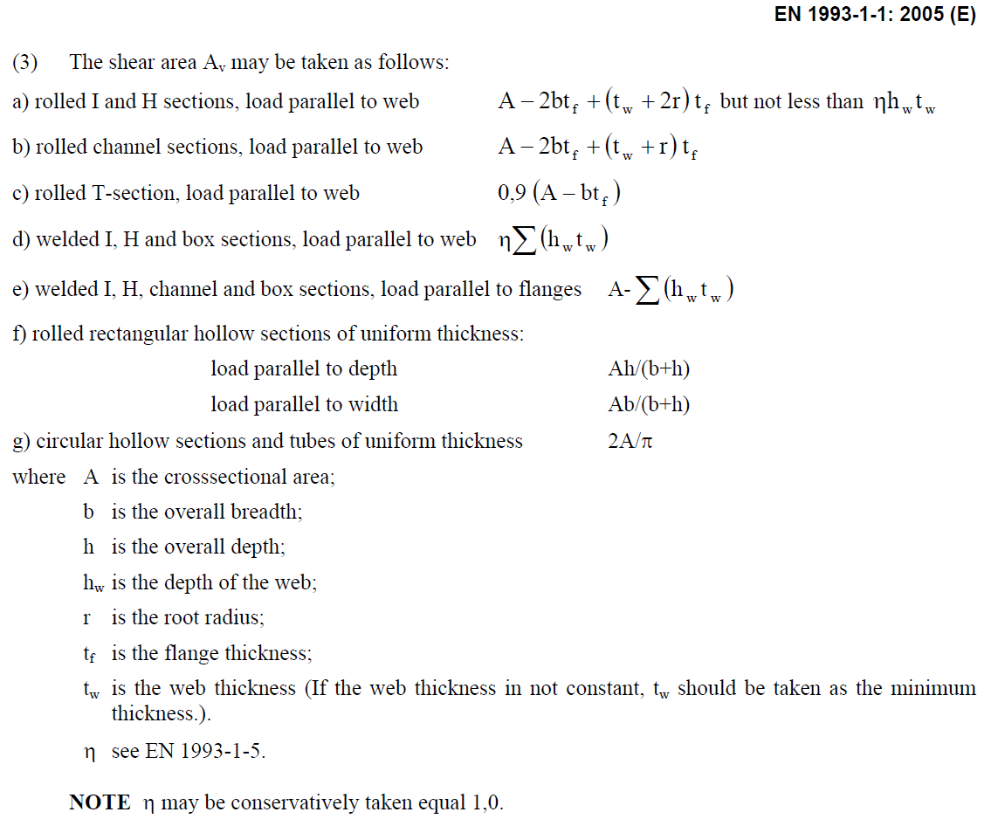
Shear area

Slide 23
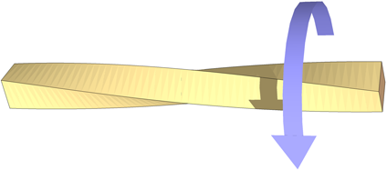
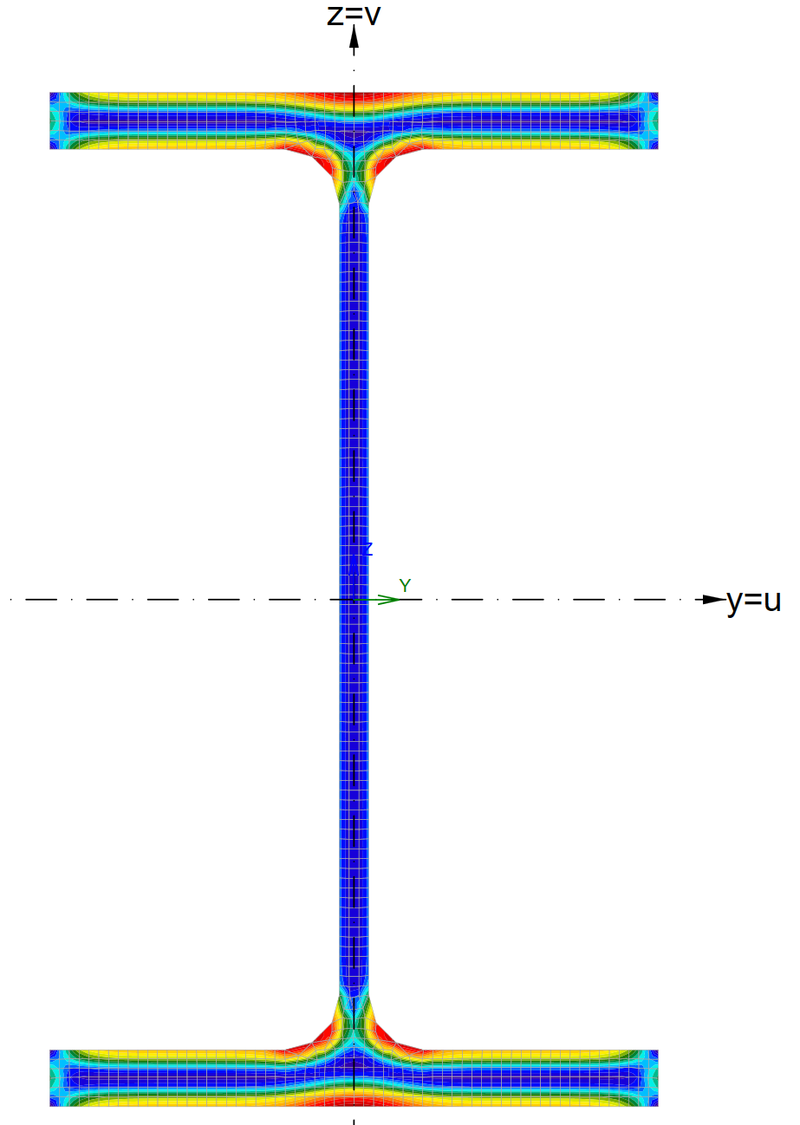
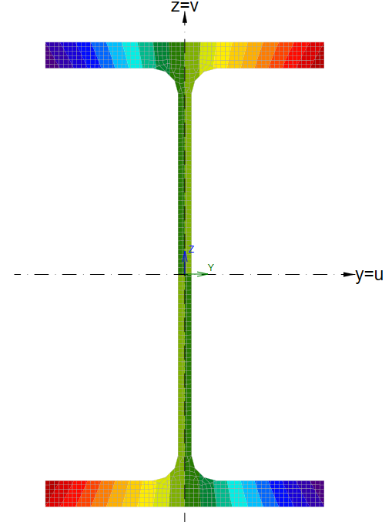
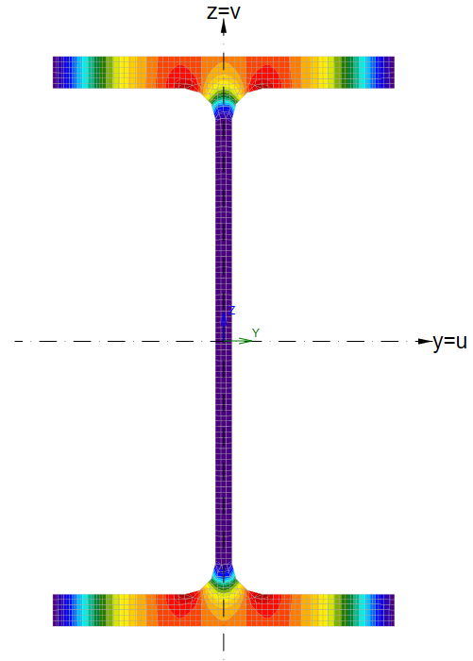



Torsion
Saint Venant torsion
Warping
$$τ_{yz}$$
$$σ_{x}$$
$$τ_{yz}$$

Slide 24
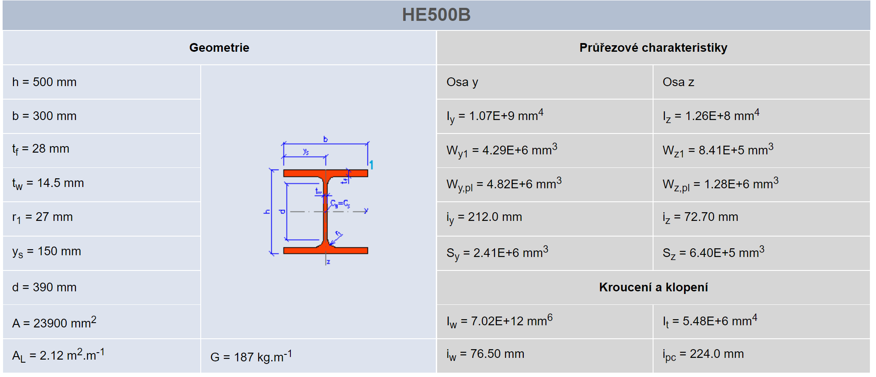
Cross-section properties – Table
http://www.staticstools.eu/cs/

Slide 25



Center of gravity
$$z$$
$S_{y}=\int_{A}{zdA}$
$S_{y}=\sum_{i=1}^{n}{b_{i}⋅t_{i}}⋅z$
$S_{z}=\int_{A}{ydA}$
$S_{z}=\sum_{i=1}^{n}{b_{i}⋅t_{i}}⋅y$
$C_{g,y}=\frac{S_{z}}{A}$
$C_{g,z}=\frac{S_{y}}{A}$
$C_{g} \left[C_{g,y};C_{g,z}\right]$
$$y$$

Slide 26

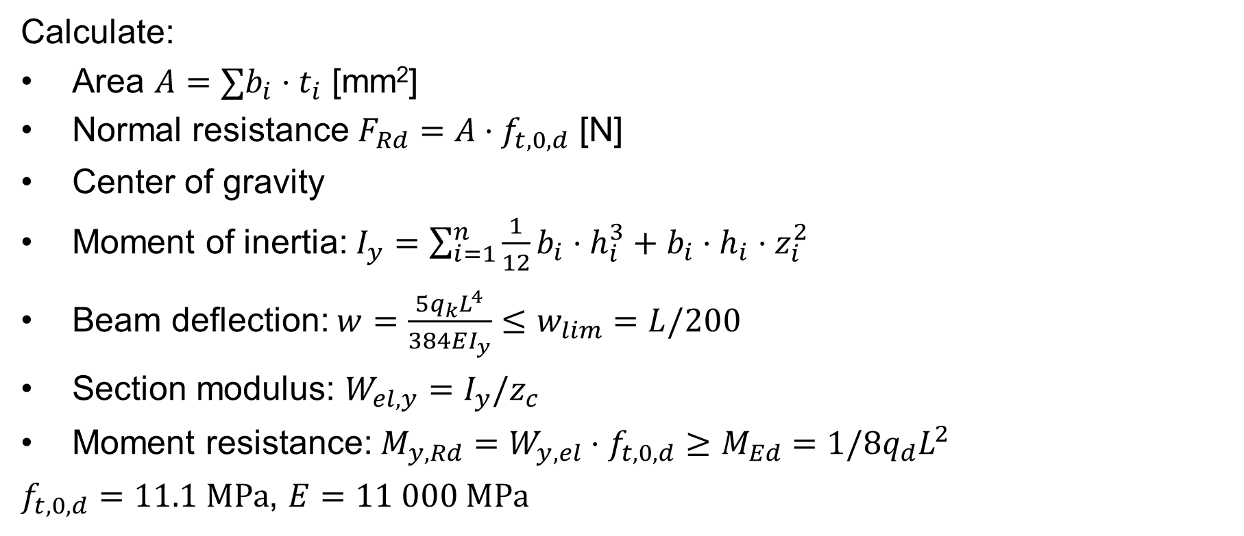
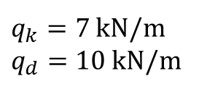
Example
$q_{k}=7$ kN/m
$q_{d}=10$kN/m
Calculate:
Area $A=∑b_{i}⋅t_{i}$ [mm²]
Normal resistance $F_{Rd}=A⋅f_{t,0,d}$ [N]
Center of gravity
Moment of inertia:$I_{y}=\sum_{i=1}^{n}{\frac{1}{12}b_{i}⋅h_{i}^{3}+b_{i}⋅h_{i}⋅z_{i}^{2}}$
Beam deflection: $w=\frac{5q_{k}L^{4}}{384EI_{y}}≤w_{lim}=L/200$
Section modulus: $W_{el,y}=I_{y}/z_{c}$
Moment resistance: $M_{y,Rd}=W_{y,el}⋅f_{t,0,d}≥M_{Ed}=1/8q_{d}L^{2}$
$f_{t,0,d}=11.1 MPa$, $E=11 000 MPa$
$$L=4 m$$
80
200
80
80
80
[mm]

